Slide 1

Predicting Stock Prices for Businesses Through Historical Events
Team A:
Akshitha Karthick Kumar
Babitha Govindaiah
Gabriella Albarez
Nirali Karsaliya
Pooja Priya

Slide 2

Table of Contents
Business Scenario
Companies stock details
Data Collection
Data Cleaning & Data Transformation
Data Visualization of Stock Prices
Data Variables
GitHub links

Slide 3


Business Scenario
The purpose of this project is to see the impact that news data has on stock prices of 4 companies from each of the following industries over the span of 2 years:
Tech industry
Health industry
Manufacturing industry
Finance industry

Slide 4

Business Scenario
This analysis will help determine how the stock prices fluctuate depending on the type of news and answer questions such as:
Does news about tech issues impact other industries other than tech?
Which industry appears to be most volatile and why?
Do different industries react differently to similar news?

Slide 5




Stock Company Details
Tech Industry: Google, Meta, Netflix, Amazon
Finance Industry: Capital One, Citi Group, Mastercard, Chase
Healthcare Industry: Pfizer, Merck, AstraZeneca, Johnson & Johnson
Manufacturing Industry: General Motors, Toyota Motors, Apple, Intel

Slide 6
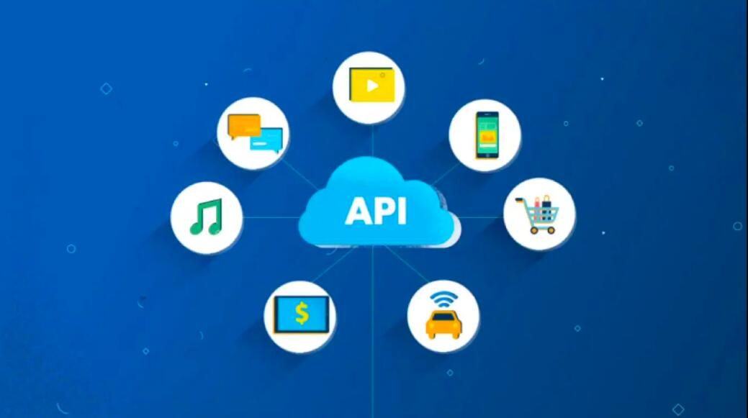
Data Collection
Alpha Vantage API used to collect data on historical stock prices from 2020-Current
New York Times API used to collect data on news data from 2020-Current

Slide 7

Data Cleaning & Data Transformation
Removal of duplicate and irrelevant observations
Fixed structural errors
Data Transformation

Slide 8
Stock Data Variables
Date: Used to evaluate different prices of stock based on date
Time: Used to see how stock prices change based on 1 minute increment
Open: Stock price when market opens
High: Highest stock price within 1 minute time frame
Low: Lowest stock price within 1 minute time frame
Close: Stock price when market closes on that date

Slide 9
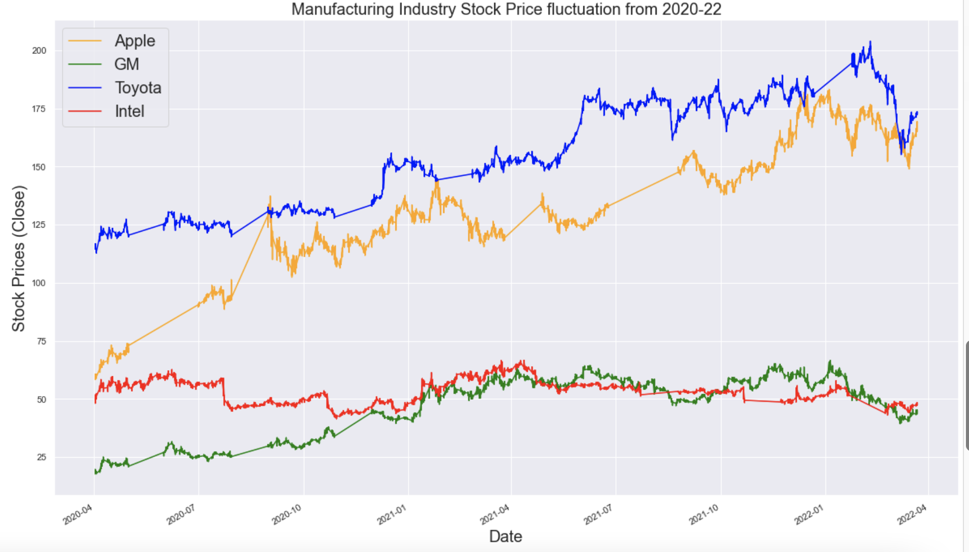
Manufacturing Industry
Toyota
Apple
Intel
GM

Slide 10
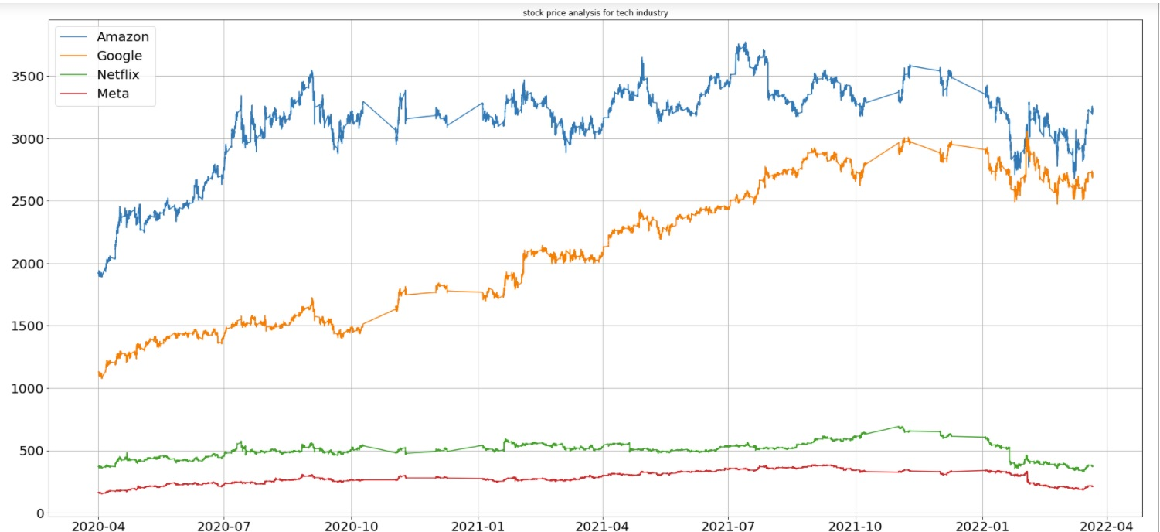
Tech Industry
Google
Meta
Amazon
Netflix

Slide 11
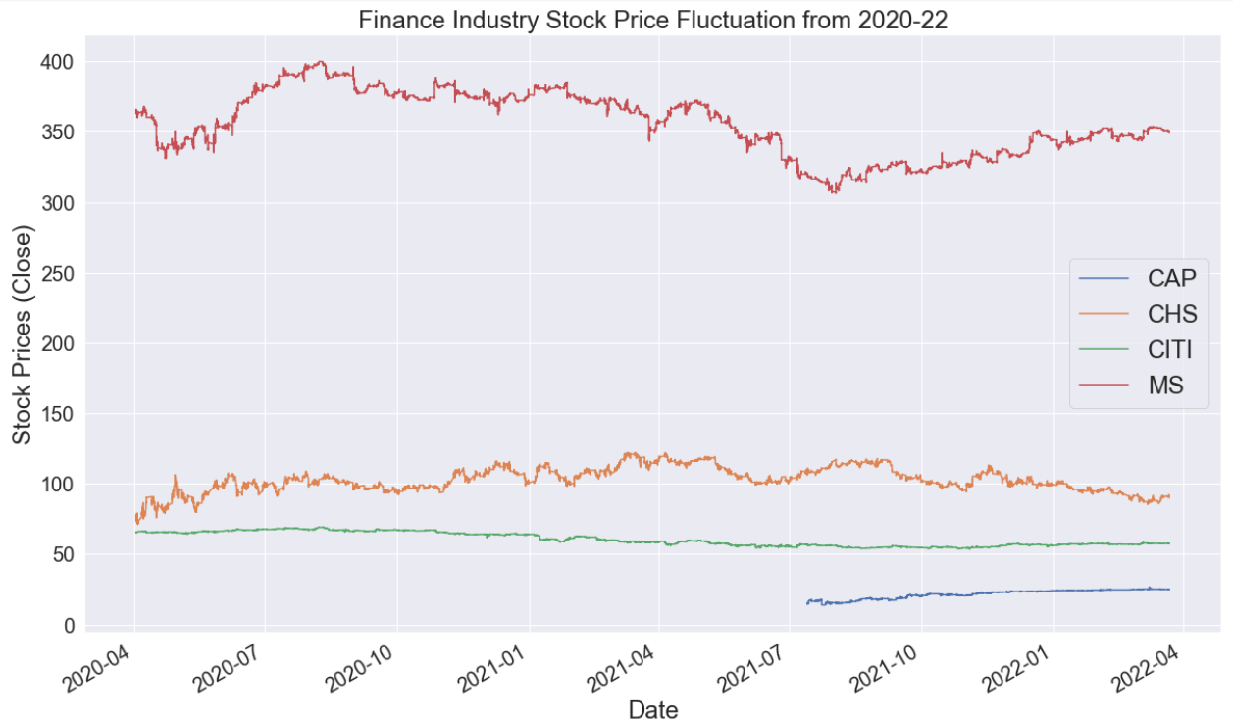
Finance Industry
Mastercard
Chase Corp
Citigroup
CapitalOne

Slide 12
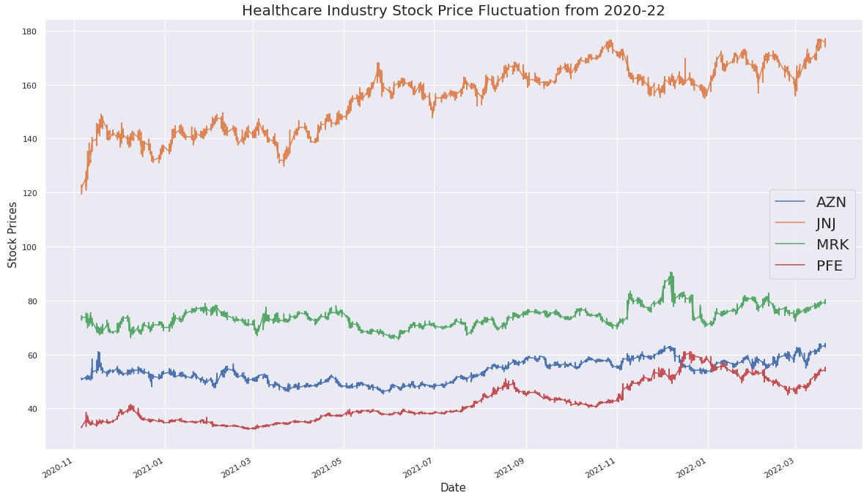
Healthcare Industry
JNJ
MRK
AZN
PFE

Slide 13
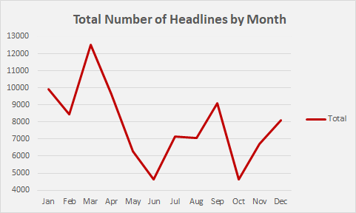
News Data
Headlines from New York Times archive
01/01/2020 to 03/24/2022
Expected – March highest with covid
Some keywords:
Health, Technology, Finance, Business, Economy, Real Estate, Politics

Slide 14

News Data Variables
Headline: Basic information about the news article
Date: Date that the article was published
Doc_type: Type of format (article or multimedia)
URL: URL to the article
Snippet: Short summary of the article
Keywords: Used to identify articles based on certain keywords

Slide 15
GitHub
https://github.com/nkarsaliya/ML_Project
References
Alpha Advantage Stock API:
https://www.alphavantage.co/
News Data API:
https://developer.nytimes.com/apis

Slide 16
Thank you!

